Slide 1
Writing Basic
SQL SELECT Statements
Notes:
Schedule: Timing Topic
40 minutes Lecture
25 minutes Practice
65 minutes Total

Slide 2
Objectives
After completing this lesson, you should be able to
do the following:
List the capabilities of SQL SELECT statements
Execute a basic SELECT statement
Notes:
Lesson Aim
To extract data from the database, you need to use the structured query language (SQL) SELECT statement. You may need to restrict the columns that are displayed. This lesson describes all the SQL statements needed to perform these actions.
You may want to create SELECT statements that can be used more than once. This lesson also covers the iSQL*Plus environment where you execute SQL statements.
Note: iSQL*Plus is new in the Oracle9i product. It is a browser environment where you execute SQL commands. In prior releases of Oracle, SQL*Plus was the default environment where you executed SQL commands. SQL*Plus is still available and is described in Appendix C.

Slide 3
SQL and iSQL*Plus Interaction
SQL statements
iSQL*Plus
Internet
Browser
Oracle
server
iSQL*Plus
commands
Query results
Formatted report
Client
Notes:
SQL and iSQL*Plus
SQL is a command language for communication with the Oracle server from any tool or application. Oracle SQL contains many extensions.
iSQL*Plus is an Oracle tool that recognizes and submits SQL statements to the Oracle server for execution and contains its own command language.
Features of SQL
Can be used by a range of users, including those with little or no programming experience
Is a nonprocedural language
Reduces the amount of time required for creating and maintaining systems
Is an English-like language
Features of iSQL*Plus
Accessed from a browser
Accepts ad hoc entry of statements
Provides online editing for modifying SQL statements
Controls environmental settings
Formats query results into a basic report
Accesses local and remote databases

Slide 4
SQL Statements Versus iSQL*Plus Commands
SQL
  A language
  ANSI standard
  Keyword cannot be abbreviated
  Statements manipulate data and table definitions in the database
iSQL*Plus
  An environment
  Oracle proprietary
  Keywords can be abbreviated
  Commands do not allow manipulation of values in the database
  Runs on a browser
  Centrally loaded, does not have to be implemented on each machine
SQL
statements
iSQL*Plus
commands
Notes:
SQL and iSQL*Plus (continued)
The following table compares SQL and iSQL*Plus:

Slide 5
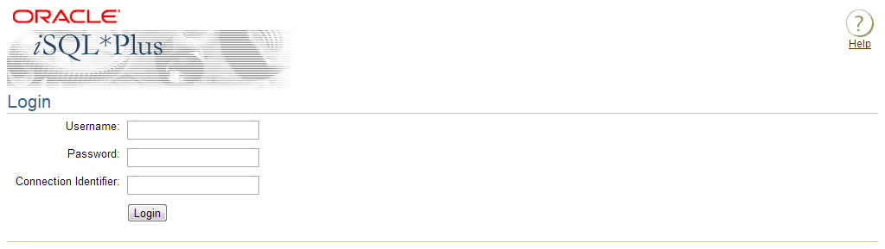
Logging In to iSQL*Plus
  From your Windows browser environment:
Notes:
Logging In to iSQL*Plus
To log in through a browser environment:
1. Start the browser.
2. Enter the URL address of the iSQL*Plus environment.
3. Fill in the username, password and Oracle Connection Identifier fields.

Slide 6
User Account
Username : Scott
Password : Tiger

Slide 7
Overview of iSQL*Plus
After you log into iSQL*Plus, you can:
Describe the table structure
Edit your SQL statement
Execute SQL from iSQL*Plus
Save SQL statements to files and append SQL statements to files
Execute statements stored in saved files
Load commands from a text file into the iSQL*Plus Edit window
Notes:
iSQL*Plus
iSQL*Plus is an environment in which you can do the following:
Execute SQL statements to retrieve, modify, add, and remove data from the database
Format, perform calculations on, store, and print query results in the form of reports
Create script files to store SQL statements for repetitive use in the future
iSQL*Plus commands can be divided into the following main categories:

Slide 8
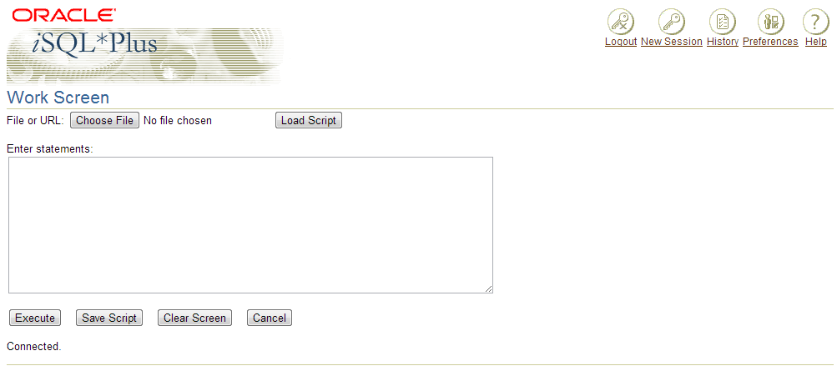
The iSQL*Plus Environment
8
10
12
6
7
9
11
1
2
3
4
5
Notes:
The iSQL*Plus Environment
Within the Windows browser, the iSQL*Plus window has several key areas:
1. Edit window: The area where you type the SQL statements and iSQL*Plus commands.
2. Execute button: Click to execute the statements and commands in the edit window.
3. Output Option: Defaults to Work Screen, which displays the results of the SQL statement beneath the edit window. The other options are File or Window. File saves the contents to a specified file. Window places the output on the screen, but in a separate window.
4. Clear Screen button: Click to clear text from the edit window.
5. Save Script button: Saves the contents of the edit window to a file.
6. Script Locator: Identifies the name and location of a script file that you want to execute.
7. Browse button: Used to search for a script file using the Windows File Open dialog box.
8. Exit icon: Click to end the iSQL*Plus session and return to the iSQL*Plus LogOn window.
9. Help icon: Provides access to iSQL*Plus Help documentation.
10. Password button: Is used to change your password.

Slide 9
Writing SQL Statements
SQL statements are not case sensitive.
SQL statements can be on one or more lines.
Keywords cannot be abbreviated or split
across lines.
Clauses are usually placed on separate lines.
Indents are used to enhance readability.
Notes:
Writing SQL Statements
Using the following simple rules and guidelines, you can construct valid statements that are both easy to read and easy to edit:
• SQL statements are not case sensitive, unless indicated.
SQL statements can be entered on one or many lines.
• Keywords cannot be split across lines or abbreviated.
Clauses are usually placed on separate lines for readability and ease of editing.
• Indents should be used to make code more readable.
Keywords typically are entered in uppercase; all other words, such as table names and columns, are entered in lowercase.
Executing SQL Statements
Using iSQL*Plus, click the Execute button to run the command or commands in the editing
window.
Instructor Note
Although not required in iSQL*Plus, placing a semicolon (;) at the end of the last clause is recommended. Other environments, such as PL/SQL programs, require that the end of each statement contains a semicolon.

Slide 10
Capabilities of SQL SELECT Statements
Projection
Selection
Table 1
Table 1
Join
Table 1
Table 2
Notes:
Capabilities of SQL SELECT Statements
A SELECT statement retrieves information from the database. Using a SELECT statement, you can do the following:
Projection: You can use the projection capability in SQL to choose the columns in a table that you want returned by your query. You can choose as few or as many columns of the table as you require.
Selection: You can use the selection capability in SQL to choose the rows in a table that you want returned by a query. You can use various criteria to restrict the rows that you see.
Joining: You can use the join capability in SQL to bring together data that is stored in different tables by creating a link between them. You learn more about joins in a later lesson.
Instructor Note
Inform students that selection and projection are often considered horizontal and vertical partitioning.

Slide 11
Basic SELECT Statement
SELECT *|{[DISTINCT] column|expression [alias],...}
FROM table;
SELECT identifies what columns
FROM identifies which table
Notes:
Basic SELECT Statement
In its simplest form, a SELECT statement must include the following:
A SELECT clause, which specifies the columns to be displayed
A FROM clause, which specifies the table containing the columns listed in the SELECT clause
In the syntax:
SELECT is a list of one or more columns
* selects all columns
DISTINCT suppresses duplicates
column|expression selects the named column or the expression
alias gives selected columns different headings
FROM table specifies the table containing the columns
Note: Throughout this course, the words keyword, clause, and statement are used as follows:
A keyword refers to an individual SQL element.
For example, SELECT and FROM are keywords.
A clause is a part of a SQL statement.
For example, SELECT employee_id, last_name, ... is a clause.
A statement is a combination of two or more clauses.
For example, SELECT * FROM employees is a SQL statement.

Slide 12
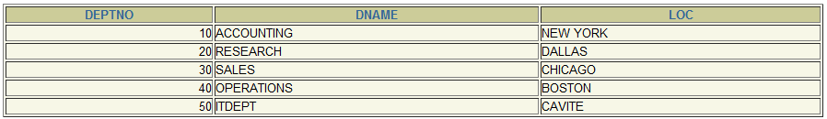
Selecting All Columns
SELECT *
FROM dept;
Notes:
Selecting All Columns of All Rows
You can display all columns of data in a table by following the SELECT keyword with an asterisk (*). In the example on the slide, the department table contains four columns: DEPARTMENT_ID, DEPARTMENT_NAME, MANAGER_ID, and LOCATION_ID. The table contains seven rows, one for each department.
You can also display all columns in the table by listing all the columns after the SELECT keyword. For example, the following SQL statement, like the example on the slide, displays all columns and all rows of the DEPARTMENTS table:
SELECT department_id, department_name, manager_id, location_id
FROM departments;
Instructor Note
Let the students know that details of all the tables are given in Appendix B.

Slide 13
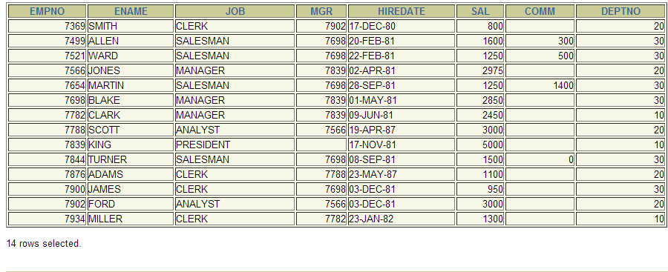
Selecting All Columns
SELECT *
FROM emp;
Notes:
Selecting All Columns of All Rows
You can display all columns of data in a table by following the SELECT keyword with an asterisk (*). In the example on the slide, the department table contains four columns: DEPARTMENT_ID, DEPARTMENT_NAME, MANAGER_ID, and LOCATION_ID. The table contains seven rows, one for each department.
You can also display all columns in the table by listing all the columns after the SELECT keyword. For example, the following SQL statement, like the example on the slide, displays all columns and all rows of the DEPARTMENTS table:
SELECT department_id, department_name, manager_id, location_id
FROM departments;
Instructor Note
Let the students know that details of all the tables are given in Appendix B.

Slide 14
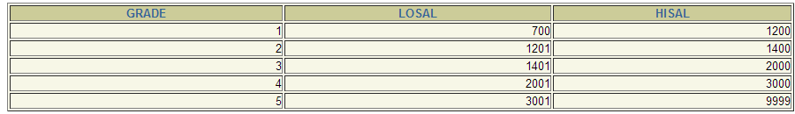
Selecting All Columns
SELECT *
FROM salgrade;
Notes:
Selecting All Columns of All Rows
You can display all columns of data in a table by following the SELECT keyword with an asterisk (*). In the example on the slide, the department table contains four columns: DEPARTMENT_ID, DEPARTMENT_NAME, MANAGER_ID, and LOCATION_ID. The table contains seven rows, one for each department.
You can also display all columns in the table by listing all the columns after the SELECT keyword. For example, the following SQL statement, like the example on the slide, displays all columns and all rows of the DEPARTMENTS table:
SELECT department_id, department_name, manager_id, location_id
FROM departments;
Instructor Note
Let the students know that details of all the tables are given in Appendix B.

Slide 15
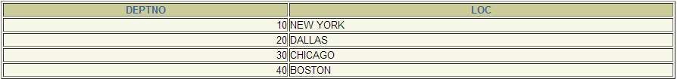
Selecting Specific Columns
SELECT deptno, loc
FROM dept;
Notes:
Selecting Specific Columns of All Rows
You can use the SELECT statement to display specific columns of the table by specifying the column names, separated by commas. The example on the slide displays all the department numbers and location numbers from the DEPARTMENTS table.
In the SELECT clause, specify the columns that you want, in the order in which you want them to appear in the output. For example, to display location before department number going from left to right, you use the following statement:
SELECT location_id, department_id
FROM departments;
Instructor Note
You can also select from pseudocolumns. A pseudocolumn behaves like a table column but is not actually stored in the table. You cannot insert or delete values of the pseudocolumns. Some available pseudocolumns are CURRVAL, NEXTVAL, LEVEL, ROWID, and ROWNUM.
…

Slide 16
Column Heading Defaults
iSQL*Plus:
  Default heading justification: Center
  Default heading display: Uppercase
SQL*Plus:
  Character and Date column headings are left- justified
  Number column headings are right-justified
  Default heading display: Uppercase
Notes:
Column Heading Defaults
In iSQL*Plus, column headings are displayed in uppercase and centered.
SELECT last_name, hire_date, salary
FROM employees;
You can override the column heading display with an alias. Column aliases are covered later in this lesson.
…

Slide 17
Arithmetic Expressions
Create expressions with number and date data by using arithmetic operators.
Operator
+
-
*
/
Description
Add
Subtract
Multiply
Divide
Notes:
Arithmetic Expressions
You may need to modify the way in which data is displayed, perform calculations, or look at what-if scenarios. These are all possible using arithmetic expressions. An arithmetic expression can contain column names, constant numeric values, and the arithmetic operators.
Arithmetic Operators
The slide lists the arithmetic operators available in SQL. You can use arithmetic operators in any clause of a SQL statement except in the FROM clause.
Instructor Note
You can use the addition and subtraction operators only with DATE and TIMESTAMP data types.

Slide 18
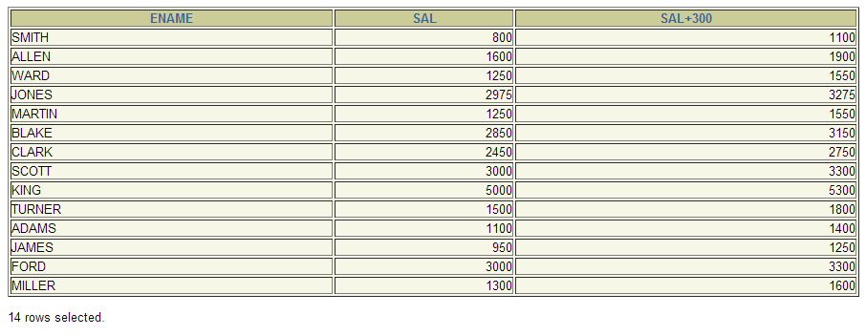
Using Arithmetic Operators
SELECT ename, sal, sal + 300
FROM emp;
Notes:
Using Arithmetic Operators
The example in the slide uses the addition operator to calculate a salary increase of $300 for all employees and displays a new SALARY+300 column in the output.
Note that the resultant calculated column SALARY+300 is not a new column in the EMPLOYEES table; it is for display only. By default, the name of a new column comes from the calculation that generated it—in this case, salary+300.
Note: The Oracle9i server ignores blank spaces before and after the arithmetic operator.

Slide 19
Operator Precedence
_
*
/
+
Multiplication and division take priority over addition and subtraction.
Operators of the same priority are evaluated from left to right.
Parentheses are used to force prioritized evaluation and to clarify statements.
Notes:
Operator Precedence
If an arithmetic expression contains more than one operator, multiplication and division are evaluated first. If operators within an expression are of same priority, then evaluation is done from left to right.
You can use parentheses to force the expression within parentheses to be evaluated first.

Slide 20

Operator Precedence
SELECT ename, sal, 12*sal+100
FROM emp;
Notes:
Operator Precedence (continued)
The example on the slide displays the last name, salary, and annual compensation of employees. It calculates the annual compensation as 12 multiplied by the monthly salary, plus a one-time bonus of $100. Notice that multiplication is performed before addition.
Note: Use parentheses to reinforce the standard order of precedence and to improve clarity. For example, the expression on the slide can be written as (12*salary)+100 with no change in the result.
Instructor Note
Demo: 1_prec1.sql, 1_prec2.sql
Purpose: To illustrate viewing a query containing no parentheses and executing a query with parentheses to override rules of precedence.

Slide 21
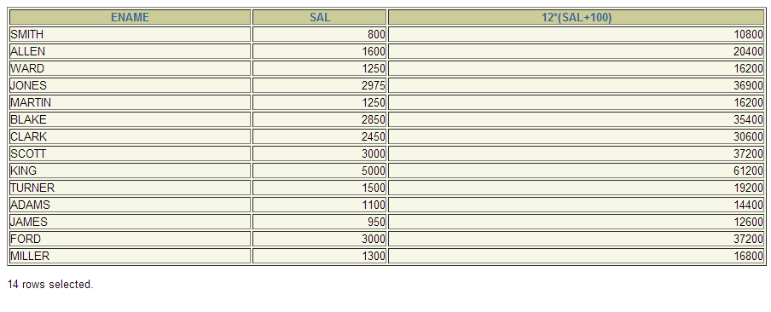
Using Parentheses
SELECT ename, sal, 12*(sal+100)
FROM emp;
Notes:
Using Parentheses
You can override the rules of precedence by using parentheses to specify the order in which operators are executed.
The example on the slide displays the last name, salary, and annual compensation of employees. It calculates the annual compensation as monthly salary plus a monthly bonus of $100, multiplied by 12. Because of the parentheses, addition takes priority over multiplication.

Slide 22
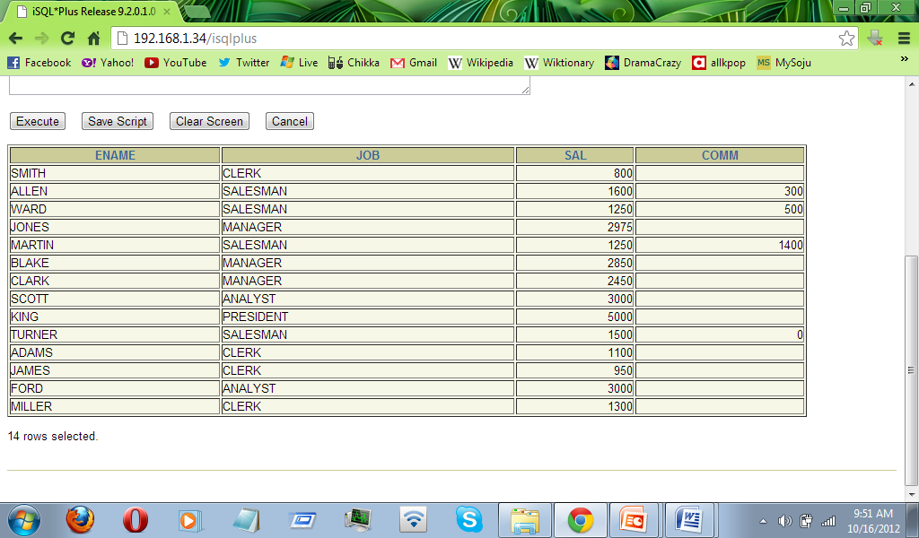
Defining a Null Value
A null is a value that is unavailable, unassigned, unknown, or inapplicable.
A null is not the same as zero or a blank space.
SELECT ename, job, sal, comm
FROM emp;
…
Notes:
Null Values
If a row lacks the data value for a particular column, that value is said to be null, or to contain a null.
A null is a value that is unavailable, unassigned, unknown, or inapplicable. A null is not the same as zero or a space. Zero is a number, and a space is a character.
Columns of any data type can contain nulls. However, some constraints, NOT NULL and PRIMARY KEY, prevent nulls from being used in the column.
In the COMMISSION_PCT column in the EMPLOYEES table, notice that only a sales manager or sales representative can earn a commission. Other employees are not entitled to earn commissions. A null represents that fact.
Instructor Note
Demo: 1_null.sql
Purpose: To illustrate calculating with null values.

Slide 23
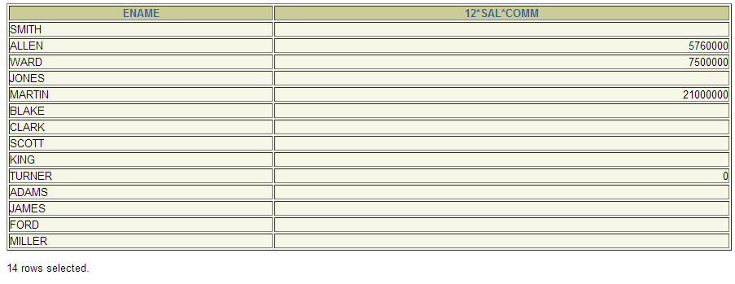
Null Values in Arithmetic Expressions
Arithmetic expressions containing a null value
evaluate to null.
SELECT ename, 12*sal*comm
FROM emp;
Notes:
Null Values (continued)
If any column value in an arithmetic expression is null, the result is null. For example, if you attempt to perform division with zero, you get an error. However, if you divide a number by null, the result is a null or unknown.
In the example on the slide, employee King does not get any commission. Because the COMMISSION_PCT column in the arithmetic expression is null, the result is null.
For more information, see Oracle9i SQL Reference, “Basic Elements of SQL.”

Slide 24
Defining a Column Alias
A column alias:
Renames a column heading
Is useful with calculations
Immediately follows the column name - there can also be the optional AS keyword between the column name and alias
Requires double quotation marks if it contains spaces or special characters or is case sensitive
Notes:
Column Aliases
When displaying the result of a query, iSQL*Plus normally uses the name of the selected column as the column heading. This heading may not be descriptive and hence may be difficult to understand. You can change a column heading by using a column alias.
Specify the alias after the column in the SELECT list using a space as a separator. By default, alias headings appear in uppercase. If the alias contains spaces or special characters (such as # or $), or is case sensitive, enclose the alias in double quotation marks (" ").
Instructor Note
Within a SQL statement, a column alias can be used in both the SELECT clause and the ORDER BY clause. You cannot use column aliases in the WHERE clause. Both alias features comply with the ANSI SQL 92 standard.
Demo: 1_alias.sql
Purpose: To illustrate the use of aliases in expressions.

Slide 25
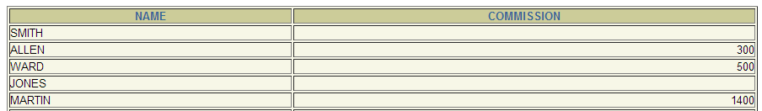
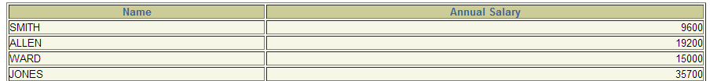
Using Column Aliases
SELECT ename AS name, comm commission
FROM emp;
SELECT ename "Name", sal*12 "Annual Salary"
FROM emp;
Notes:
Column Aliases (continued)
The first example displays the names and the commission percentages of all the employees. Notice that the optional AS keyword has been used before the column alias name. The result of the query is the same whether the AS keyword is used or not. Also notice that the SQL statement has the column aliases, name and comm, in lowercase, whereas the result of the query displays the column headings in uppercase. As mentioned in a previous slide, column headings appear in uppercase by default.
The second example displays the last names and annual salaries of all the employees. Because Annual Salary contain a space, it has been enclosed in double quotation marks. Notice that the column heading in the output is exactly the same as the column alias.
Instructor Note
Point out the optional AS keyword in the first example and the double quotation marks in the second example. Also show that the aliases always appear in uppercase, unless enclosed within double quotation marks.

Slide 26
Concatenation Operator
A concatenation operator:
Concatenates columns or character strings to other columns
Is represented by two vertical bars (||)
Creates a resultant column that is a character expression
Notes:
Concatenation Operator
You can link columns to other columns, arithmetic expressions, or constant values to create a character expression by using the concatenation operator (||). Columns on either side of the operator are combined to make a single output column.

Slide 27
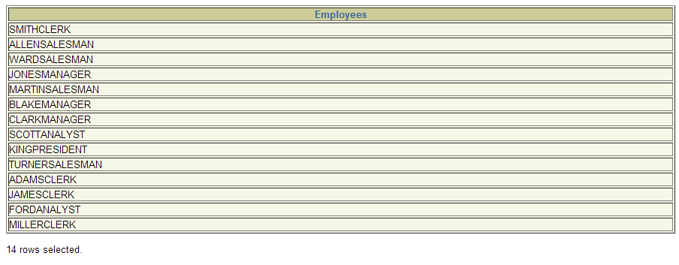
Using the Concatenation Operator
SELECT ename||job AS "Employees"
FROM emp;
Notes:
Concatenation Operator (continued)
In the example, LAST_NAME and JOB_ID are concatenated, and they are given the alias Employees. Notice that the employee last name and job code are combined to make a single output column.
The AS keyword before the alias name makes the SELECT clause easier to read.

Slide 28
Literal Character Strings
A literal is a character, a number, or a date included in the SELECT list.
Date and character literal values must be enclosed within single quotation marks.
Each character string is output once for each
row returned.
Notes:
Literal Character Strings
A literal is a character, a number, or a date that is included in the SELECT list and that is not a column name or a column alias. It is printed for each row returned. Literal strings of free-format text can be included in the query result and are treated the same as a column in the SELECT list.
Date and character literals must be enclosed within single quotation marks (' '); number literals need not.

Slide 29
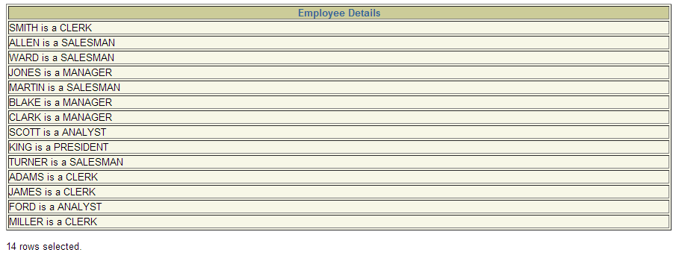
Using Literal Character Strings
SELECT ename ||' is a ' || job
AS "Employee Details"
FROM emp;
Notes:
Literal Character Strings (continued)
The example on the slide displays last names and job codes of all employees. The column has the heading Employee Details. Notice the spaces between the single quotation marks in the SELECT statement. The spaces improve the readability of the output.
In the following example, the last name and salary for each employee are concatenated with a literal to give the returned rows more meaning.
SELECT last_name ||': 1 Month salary = '||salary Monthly
FROM employees;
…

Slide 30
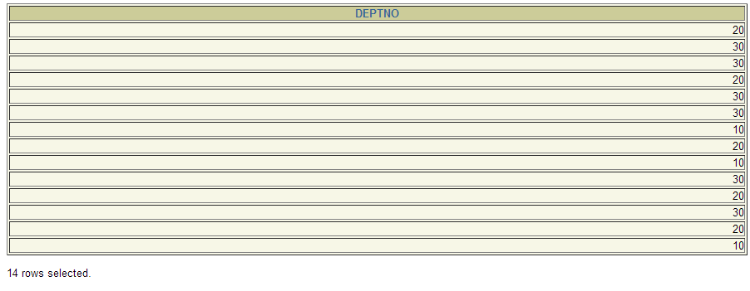
Duplicate Rows
The default display of queries is all rows, including
duplicate rows.
SELECT deptno
FROM emp;
Notes:
Duplicate Rows
Unless you indicate otherwise, iSQL*Plus displays the results of a query without eliminating duplicate rows. The example on the slide displays all the department numbers from the EMPLOYEES table. Notice that the department numbers are repeated.

Slide 31
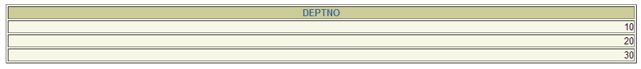
Eliminating Duplicate Rows
Eliminate duplicate rows by using the DISTINCT keyword in the SELECT clause.
SELECT DISTINCT deptno
FROM emp;
Notes:
Duplicate Rows (continued)
To eliminate duplicate rows in the result, include the DISTINCT keyword in the SELECT clause immediately after the SELECT keyword. In the example on the slide, the EMPLOYEES table actually contains 20 rows but there are only seven unique department numbers in the table.
You can specify multiple columns after the DISTINCT qualifier. The DISTINCT qualifier affects all the selected columns, and the result is every distinct combination of the columns.
SELECT DISTINCT department_id, job_id
FROM employees;
…

Slide 32
Displaying Table Structure
Use the iSQL*Plus DESCRIBE command to display
the structure of a table.
DESC[RIBE] tablename
Notes:
Displaying the Table Structure
In iSQL*Plus, you can display the structure of a table using the DESCRIBE command. The command shows the column names and data types, as well as whether a column must contain data.
In the syntax:
tablename is the name of any existing table, view, or synonym accessible to the user

Slide 33
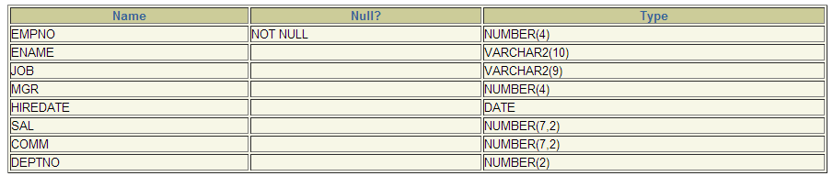
Displaying Table Structure
DESC emp;
Null? Indicates whether a column must contain
data; NOT NULL indicates that a column must
contain data.
Notes:
Displaying the Table Structure (continued)
The example on the slide displays the information about the structure of the DEPARTMENTS table.
In the result:
Null? indicates whether a column must contain data; NOT NULL indicates that a column must contain data
Type displays the data type for a column
The data types are described in the following table:
Instructor Note
Inform students that the column sequence in DESCRIBE tablename is the same as that in SELECT * FROM tablename . The order in which the columns are displayed is determined when the table is created.

Slide 34
Types
Data Type | Description
NUMBER(p,s) | Number value having a maximum number of digits p, with s digits to the right of decimal point
VARCHAR2(s) | Variable-length character value of maximum size s
DATE | Date and time value between January 1, 4712 B.C., and December 31, 9999 A.D.

Slide 35
Interacting with Script Files
SELECT last_name, hire_date, salary
FROM employees;
1
2
Notes:
Interacting with Script Files
Placing Statements and Commands into a Text Script File
You can save commands and statements from the Edit window in iSQL*Plus to a text script file as
follows:
1. Type the SQL statements into the edit window in iSQL*Plus.
2. Click the Save Script button. This opens the Windows File Save dialog box. Identify the name of the file. It defaults to .html extension. You can change the file type to a text file or save it as a .sql file.

Slide 36
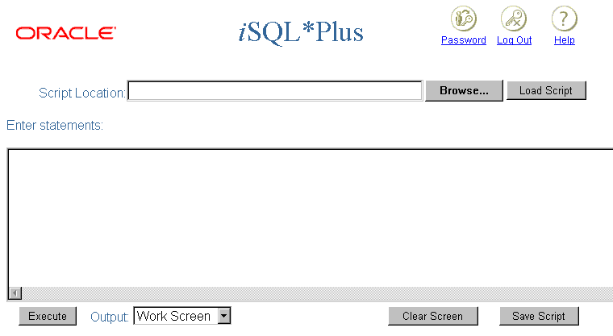
Interacting with Script Files
1
D:\temp\emp_sql.htm
SELECT last_name, hire_date, salary
FROM employees;
2
3
Notes:
Interacting with Script Files
Using Statements and Commands from a Script File in iSQL*Plus
You can use previously saved commands and statements from a script file in iSQL*Plus as follows:
1. Type in the script name and location. Or, you can click the Browse button to find the script name and location.
2. Click the Load Script button. The file contents are loaded into the iSQL*Plus edit window.
3. Click the Execute button to run the contents of the iSQL*Plus edit window.

Slide 37
Interacting with Script Files
DESCRIBE employees
SELECT first_name, last_name, job_id
FROM employees;
1
3
2
Notes:
Interacting with Script Files
Saving Output to a File
You can save the results generated from a SQL statement or iSQL*Plus command to a file:
1. Type the SQL statements and iSQL*Plus commands into the edit window in iSQL*Plus.
2. Change the output option to Save.
3. Click the Execute button to run the contents of the iSQL*Plus edit window. This opens the Windows File Save dialog box. Identify the name of the file. It defaults to a .html extension. You can change the file type. The results are sent to the file specified.

Slide 38
Summary
In this lesson, you should have learned how to:
Write a SELECT statement that:
  Returns all rows and columns from a table
  Returns specified columns from a table
  Uses column aliases to give descriptive column headings
Use the iSQL*Plus environment to write, save, and execute SQL statements and iSQL*Plus commands.
SELECT *|{[DISTINCT] column|expression [alias],...}
FROM table;
Notes:
SELECT Statement
In this lesson, you should have learned about retrieving data from a database table with the SELECT statement.
SELECT *|{[DISTINCT] column [alias],...}
FROM table;
In the syntax:
SELECT is a list of one or more columns
* selects all columns
DISTINCT suppresses duplicates
column|expression selects the named column or the expression
alias gives selected columns different headings
FROM table specifies the table containing the columns
iSQL*Plus
iSQL*Plus is an execution environment that you can use to send SQL statements to the database server and to edit and save SQL statements. Statements can be executed from the SQL prompt or from a script file.
Note: The SQL*Plus environment is covered in Appendix C.

Slide 39
Practice 1 Overview
This practice covers the following topics:
Selecting all data from different tables
Describing the structure of tables
Performing arithmetic calculations and specifying column names
Using iSQL*Plus
Notes:
Practice 1 Overview
This is the first of many practices. The solutions (if you require them) can be found in Appendix A. Practices are intended to introduce all topics covered in the lesson. Questions 2–4 are paper-based.
In any practice, there may be “if you have time” or “if you want an extra challenge” questions. Do these only if you have completed all other questions within the allocated time and would like a further challenge to your skills.
Perform the practices slowly and precisely. You can experiment with saving and running command files. If you have any questions at any time, attract the instructor’s attention.
Paper-Based Questions
For questions 2–4, circle either True or False.
Instructor Note
Let the students know that to get a listing of the tables they can access during the course, the command is:
SELECT * FROM TAB;

Slide 40
Notes:
Practice 1
1. Initiate an iSQL*Plus session using the user ID and password provided by the instructor.
2. iSQL*Plus commands access the database.
True/False
3. The following SELECT statement executes successfully:
SELECT last_name, job_id, salary AS Sal
FROM employees;
True/False
4. The following SELECT statement executes successfully:
SELECT *
FROM job_grades;
True/False
5. There are four coding errors in this statement. Can you identify them?
SELECT employee_id, last_name
sal x 12 ANNUAL SALARY
FROM employees;
6. Show the structure of the DEPARTMENTS table. Select all data from the table.

Slide 41
Notes:
Practice 1 (continued)
7. Show the structure of the EMPLOYEES table. Create a query to display the last name, job code, hire date, and employee number for each employee, with employee number appearing first. Provide an alias STARTDATE for the HIRE_DATE column. Save your SQL statement to a file named lab1_7.sql.
8. Run your query in the file lab1_7.sql.
…

Slide 42
Notes:
Practice 1 (continued)
9. Create a query to display unique job codes from the EMPLOYEES table.
If you have time, complete the following exercises:
10. Copy the statement from lab1_7.sql into the iSQL*Plus Edit window. Name the column headings Emp #, Employee, Job, and Hire Date, respectively. Run your query again.
…

Slide 43
Notes:
Practice 1 (continued)
11. Display the last name concatenated with the job ID, separated by a comma and space, and name the column Employee and Title.
If you want an extra challenge, complete the following exercise:
12. Create a query to display all the data from the EMPLOYEES table. Separate each column by a
comma. Name the column THE_OUTPUT.
…
…

Slide 44
SELECT Last_Name, job, sal as salary
FROM emp;
EXERCISES #1:
Valid or Invalid?

Slide 45
SELECT *
FROM job_grades;
EXERCISES #2:
Valid or Invalid?

Slide 46
SELECT empno, Last_name sal x 12 ANNUAL SALARY
FROM emp;
EXERCISES #3:
Valid or Invalid?

Slide 47
SHOW THE STRUCTURE OF THE DEPARTMENT TABLE. SELECT ALL DATA FROM THE TABLE.
EXERCISES #4:

Slide 48
SHOW THE STRUCTURE OF THE EMPLOYEES TABLE.
CREATE A QUERY TO DISPLAY THE LAST NAME, JOB, HIRE DATE, AND EMPLOYEE NUMBER FOR EACH EMPLOYEE, WITH EMPLOYEE NUMBER APPEARING FIRST.
PROVIDE AN ALIAS “STARTDATE” FOR THE HIRE DATE COLUMN.
EXERCISES #5:

Slide 49
CREATE A QUERY TO DISPLAY UNIQUE JOBS FROM THE EMPLOYEE TABLE.
EXERCISES #6:

Slide 50
DISPLAY THE NAME CONCATENATED WITH JOB, SEPARATED BY A COMMA AND SPACE. NAME THE COLUMN “EMPLOYEE AND TITLE”.
EXERCISES #7:

Slide 51
CREATE A QUERY TO DISPLAY ALL THE DATA FROM EMPLOYEE TABLE. SEPARATE EACH COLUMN BY A COMMA. NAME THE COLUMN “THE_OUTPUT”.
EXERCISES #8:

